Slide 1
Chapter 10
Optimization

Slide 2
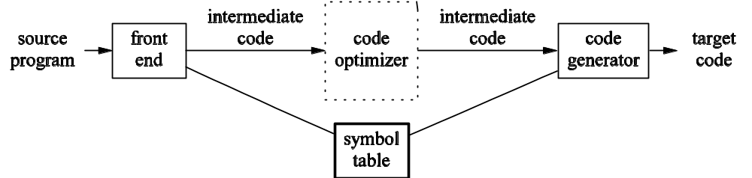
Code Optimization and Phases

Slide 3
Quicksort in C
void quicksort(int m, int n) {
int i, j, v, x;
if (n <= m) return;
/* Start of partition code */
i = m-1; j = n; v =a[n];
while (1) {
do i = i+1; while (a[i] < v);
do j = j-1; while (a[j] > v);
if (i >= j) break;
x = a[i]; a[i] = a[j]; a[j] = x;
}
x = a[i]; a[i] = a[n]; a[n] = x;
/* End of partition code */
quicksort(m, j); quicksort(i+1, n);
}

Slide 4
Partition in Three-Address Code
(1) i := m-1
(2) j := n
(3) t1 := 4*n
(4) v := a[t1]
(5) i := i+1
(6) t2 := 4*i
(7) t3 := a[t2]
(8) if t3 < v goto (5)
(9) j := j-1
(10) t4 := 4*j
(11) t5 := a[t4]
(12) if t5 > v goto (9)
(13) if i >= j goto (23)
(14) t6 := 4*i
(15) x := a[t6]
(16) t7 := 4*i
(17) t8 := 4*j
(18) t9 := a[t8]
(19) a[t7] := t9
(20) t10 := 4*j
(21) a[t10] := x
(22) goto (5)
(23) t11 := 4*i
(24) x := a[t11]
(25) t12 := 4*i
(26) t13 := 4*n
(27) t14 := a[t13]
(28) a[t12] := t14
(29) t15 := 4*n
(30) a[t15] := x

Slide 5
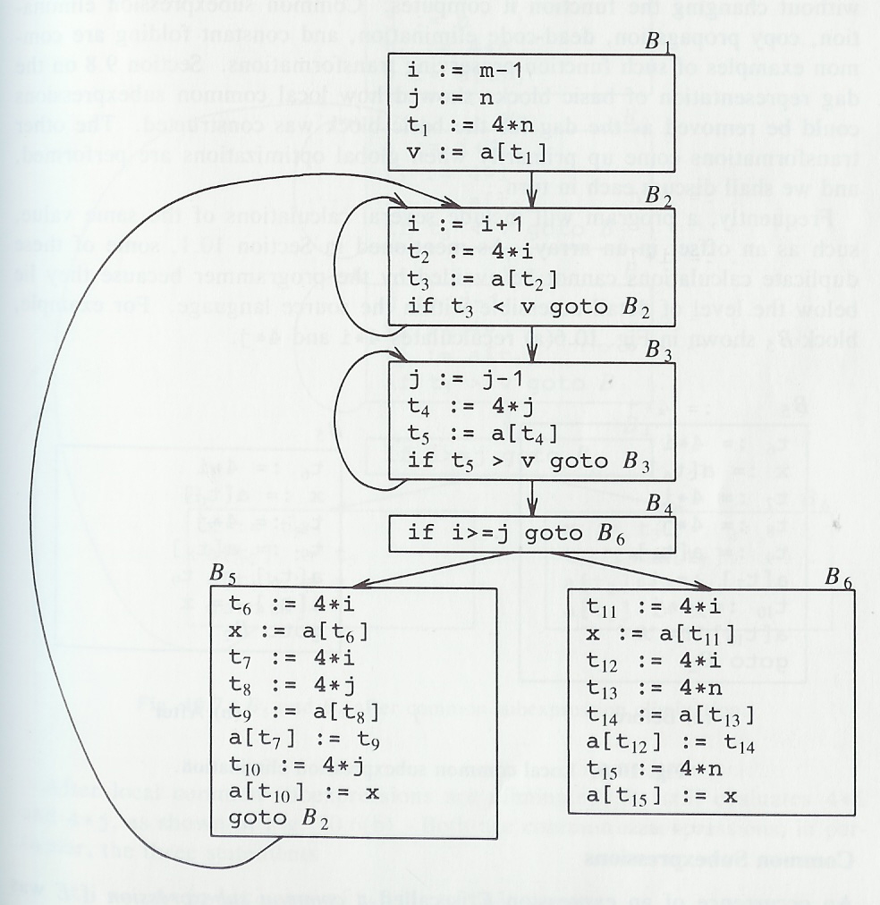
Partition Flow Graph

Slide 6
Local Common Subexpressions
t6 := 4*i
x := a[t6]
t7 := 4*i
t8 := 4*j
t9 := a[t8]
a[t7] := t9
t10 := 4*j
a[t10] := x
goto B2
t6 := 4*i
x := a[t6]
t8 := 4*j
t9 := a[t8]
a[t6] := t9
a[t8] := x
goto B2

Slide 7
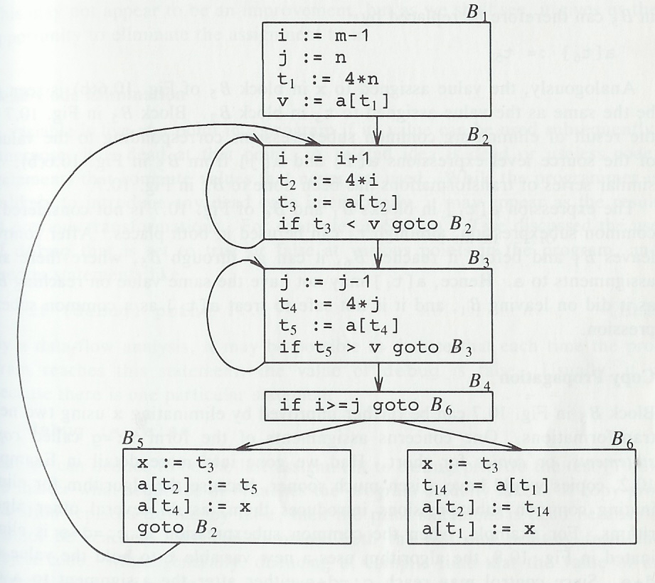
Global Common Subexpressions

Slide 8
Copy Propagation
Assignments of the form f := g are called copy statements (or copies)
The idea behind copy propagation is to use g for f whenever possible after such a statement
For example, applied to block B5 of the previous flow graph, we obtain:
  x := t3
  a[t2] := t5
  a[t4] := t3
  goto B2
Copy propagation often turns the copy statement into "dead code"

Slide 9
Dead-Code Elimination
Dead code includes code that can never be reached and code that computes a value that never gets used
Consider: if (debug) print …
  It can sometimes be deduced at compile time that the value of an expression is constant
  Then the constant can be used in place of the expression (constant folding)
  Let's assume a previous statement assigns debug := false and value never changes
  Then the print statement becomes unreachable and can be eliminated
Consider the example from the previous slide
  The value of x computed by the copy statement never gets used after the copy propagation
  The copy statement is now dead code and can be eliminated

Slide 10
Loop Optimizations (1)
The running time of a program may be improved if we do both of the following:
  Decrease the number of statements in an inner loop
  Increase the number of statements in the outer loop
Code motion moves code outside of a loop
  For example, consider:
    while (i <= limit-2) …
  The result of code motion would be:
    t = limit – 2
    while (i <= t) …

Slide 11
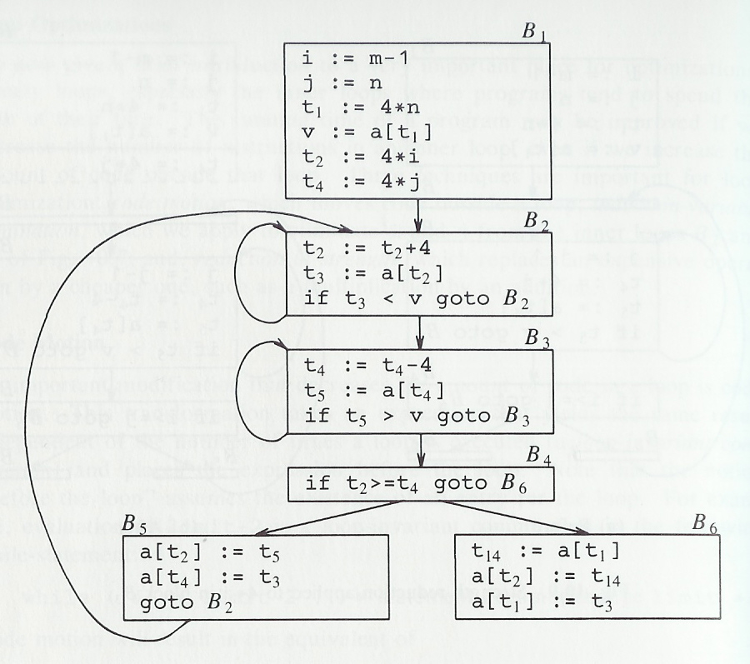
Loop Optimization Example

Slide 12

Implementing a Code Optimizer
Organization consists of control-flow analysis, then data-flow analysis, and then transformations
The code generator is applied to the transformed intermediate code
Details of code optimization are beyond the scope of this course

